Slide 1
Using MCAS Early Release Data Files ELA Grades 3–8 & 10, Round 2 Math Grades 3–8 & 10, Round 1 STE Grades 5 & 8, Round 1
The Office of Student Assessment Services June 26, 2024

Slide 2
Presenters
Shannon Cullen, MCAS Test Administration Coordinator
Scott Kelley, Reporting Specialist

Slide 3
Logistics for this Session
Use the Q&A feature to ask a question.
Some questions may be covered during the course of the presentation.
We will answer some questions at the end of this session.
After the session, we will email questions and answers to participants.
Email specific questions about individual records or about your school/district to mcas@mass.gov instead of asking here.
Use the thumbs-up icon to “upvote” someone else’s question.
This session is being recorded and will be available in about a week in the MCAS Resource Center, along with the slides.
Slides were also emailed out beforehand and are being posted in the chat.
Click the “CC” to enable closed captioning (if needed).

Slide 4
Today’s Agenda
What is (and is not) included in the MCAS Early Release?
Demonstration: Opening Your Data & Using the Item Analysis Templates
Answers to Your Questions
Early Release, Preliminary, & Discrepancy Reporting Schedules
Resources, Support, and Next Steps
Graduation Requirements & the Interim CD

Slide 5
Poll Question – Early Data in PAN
How many times have you used spring early release data in PAN?
Zero (I have never used PAN early release data.)
1 time (last year only)
2–3 times (prior 2 or 3 years)
4+ times (4+ years)

Slide 6
1. What is (and is not) included in the MCAS Early Release?

Slide 7
Early Release Data in PearsonAccess Next (PAN)
mcas.pearsonaccessnext.com
.CSV data file versions (all student-level results):
V1 selected response (ELA, grades 5 & 8 STE) and short answer (Math)
V2 constructed response (all subjects) and essays (ELA)
Item score; total raw score; possible points; percent correct
blank = no response; “–” = item not yet scored (V1)
Accommodations and accessibility features assigned
Reporting Category Results (V1 partial; V2 complete)
.PDF Student roster of results (school level only):
item scores, reporting category percent of possible points, void/medical absence flag (if appropriate)
ELA Released Essays (grade 10 only; V2)

Slide 8
Released Items and Item Information
Grade 10 Released Items and Grades 3–8 Item Information
CBT mcas.pearsonsupport.com/released-items
PBT www.doe.mass.edu/mcas/testitems.html
High school Science: to follow
Scoring rubric and examples of student work to be posted this summer:
www.doe.mass.edu/mcas/student/

Slide 9
Schedule for Early Release Data in PAN
Raw scores only; no scaled scores, achievement levels, SGP
*All dates are tentative.
Release Date | Machine-Scored (V1); Hand- and Machine-Scored (V2)
April 24 | Grade 10 ELA V1
May 16 | Grades 3–8 ELA V1
June 13 | Grade 10 ELA V2 (avail. June 6)
 | Grades 3–8 ELA V2
 | Grade 10 Essays
June 24 | Grades 3–8 Math V1
 | Grades 5 & 8 STE V1
 | Grade 10 Math V1
July 11 | HS Science V1 (V2 not in PAN)
 | Grades 3–8 Math V2
 | Grades 5 & 8 STE V2
July 19 | Grade 10 Math V2
Who has access? Superintendents, principals, district and school test coordinators. Others may be added by assigning the “Published Reports” user role in PAN.
Details available in SAS Update: http://eepurl.com/iOFQsw

Slide 10
Comparison between Machine-Scored & Hand-Scored Items
Subject/ Grade | Machine-Scored Items Included in Round 1 |  |  |  | Hand-Scored Items Included in Round 2 |  |  |  | Total
ELA grade | One-Point Selected Response | Two-point Selected Response (SR) | Machine- Scored Points | Percent Machine- Scored | Constructed Response (CR) | Essays | Hand-Scored Points | Percent Hand- Scored | Total Raw Score Points
3-4 | 24 | 5 | 34 | 77% | 1 (3 pts.) | 1 (7 pts.) | 10 | 23% | 44
5 | 24 | 5 | 34 | 71% | 0 | 2 (7 pts.) | 14 | 29% | 48
6-8 | 24 | 5 | 34 | 68% | 0 | 2 (8 pts.) | 16 | 32% | 50
10 | 21 | 7 | 35 | 69% | 0 | 2 (8 pts.) | 16 | 31% | 51
Math grade | One-Point SR Short Answer | Two-Point SR SA | Machine- Scored Points | Percent Machine- Scored | CR | N/A | Hand-Scored Points | Percent Hand- Scored | Total Raw Score Points
3 | 36 | 0 | 36 | 75% | 4 (3 pts.) |  | 12 | 25% | 48
4-8 | 34 | 2 | 38 | 70% | 4 (4 pts.) |  | 16 | 30% | 54
10 | 32 | 6 | 44 | 73% | 4 (4 pts.) |  | 16 | 27% | 60
STE grade | One-Point SR | Two-Point SR | Machine- Scored Points | Percent Machine- Scored | Two-Point CR | Three-Point CR | Hand-Scored Points | Percent Hand- Scored | Total Raw Score Points
5 & 8 | 32 | 3 | 38 | 70% | 2 | 4 | 16 | 30% | 54

Slide 11
Poll Question – MCAS Data Embargo
Who is permitted to view MCAS results during the embargo (before official release)? Select more than one, if applicable.
Curriculum director/coordinator
Teachers
Counselors
IEP team (includes parent/guardian)
All the above
None of the above

Slide 12
Using Early MCAS Results
Data are embargoed.
Use early release results for educational planning purposes within the school and district, including the following:
summer acceleration
IEP meetings
curricular decisions
Do not share aggregate results outside your organization.
Only students tested at your school/district are included; outplaced and transfer students will be reported in Aug. with full preliminary results.

Slide 13
Using Early MCAS Results (cont’d)
Identify potential discrepancies.
Report missing tests to the MCAS Service Center.
except Typed Response Form items, which will be available in the August preliminary release
Review medically absent participation status in .CSV and/or roster.
Retain potential discrepancies (incorrect SASID, accommodations, participation status) until discrepancy reporting period (August 7–12).
Identify demographic mismatches.
Report any student name changes or discrepancies to your District SIMS Contact for resolution prior to end-of-year (June) SIMS.
Use People Search to locate your District SIMS Contact on School and District Profiles.
Note that records in PAN cannot be updated.

Slide 14
2. Demonstration: Opening Your Data & Using the Item Analysis Templates

Slide 15
Secure Website for this Process
PearsonAccess Next (PAN)
http://mcas.pearsonaccessnext.com
Also linked at http://mcas.pearsonsupport.com/pearsonaccessnext/
If you used to access PAN but no longer can access it, try resetting your password in case the account expired.
If you do not have a PAN account, contact your school or district test coordinator.
Call MCAS Service Center (800-737-5103) if you still cannot access your PAN account.

Slide 16
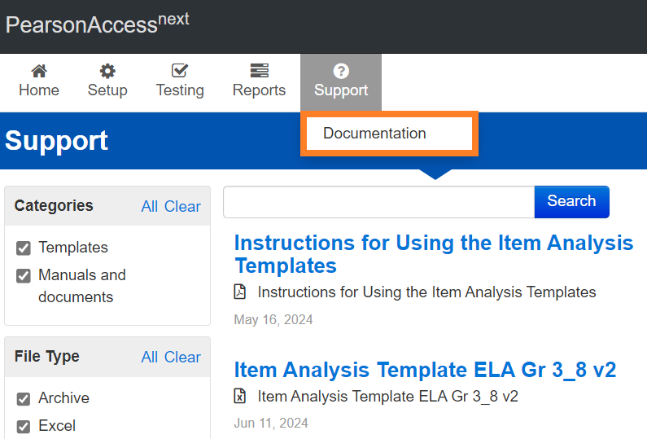
Item Analysis Template and Instructions
PearsonAccess Next
Item analysis templates pre-populated with state item results in Support > Documentation
Step-by-step Instructions for Using the Item Analysis Templates in Support > Documentation

Slide 17
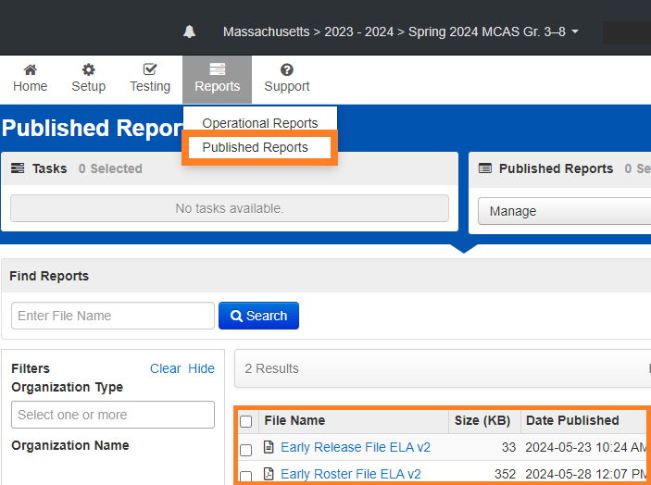
Early Release Data and Rosters
PearsonAccess Next
Early Release .CSV data file in Reports > Published Reports
Available only to PAN Users with the following roles:
principal
school test coordinator
district test coordinator
Above users can assign the “Published Reports” role to other users. Call the MCAS Service Center for assistance.

Slide 18
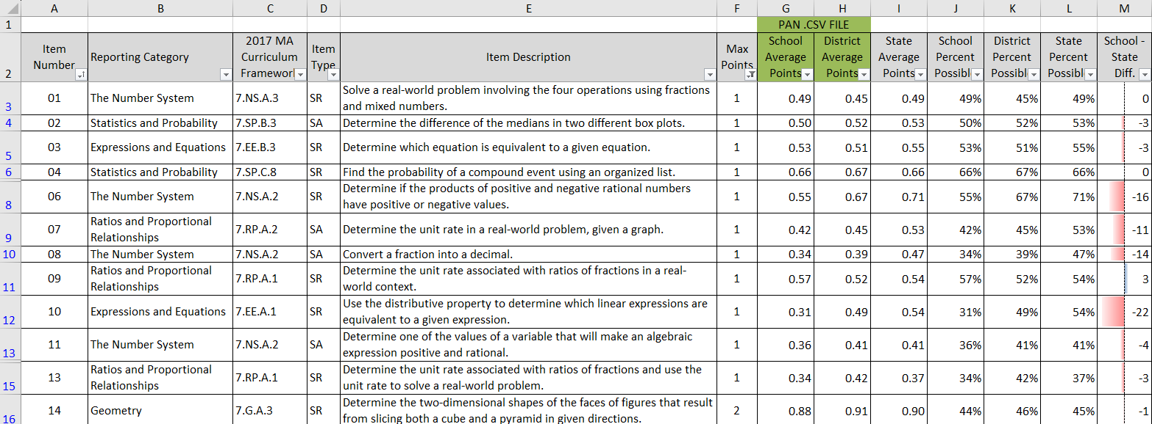
Using the Item Analysis Template (Replicates Edwin Analytics Report IT301)
Instructional video available at
www.doe.mass.edu/edwin/resources.html

Slide 19
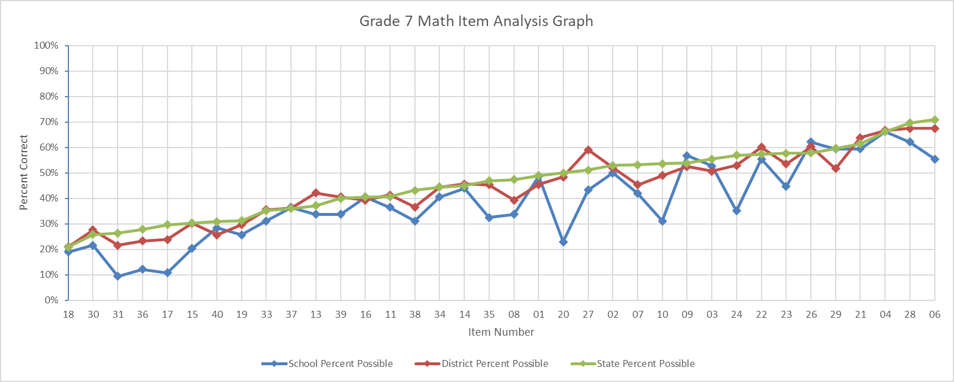
Using the Item Analysis Template (Replicates Edwin Analytics Report IT302)

Slide 20
Student .PDF Roster in PAN

Slide 21
Recap of Steps for Loading Data into Templates
Download your .CSV file from PearsonAccess Next
Insert blank rows at the top; note the last row of data in the file
Enter the subtotal formula in .CSV file: =Subtotal(1, cell range*) in a blank cell above the Item number.
Copy the subtotal formula to the row above the remaining items.
For V2, also copy the subtotal formula to the RepCat† cells.
Set filters to remove void and not tested records; use the school filter if you are a district user; set test code filter (e.g., MAT05).
Copy item subtotals from the .CSV to the template using “Paste Special” with “values” and “transpose” selected.
Save the file as a spreadsheet (.XLSX format) to preserve formulas.
*Cell Range is all records; †See Reporting Categories tab in templates for details

Slide 22
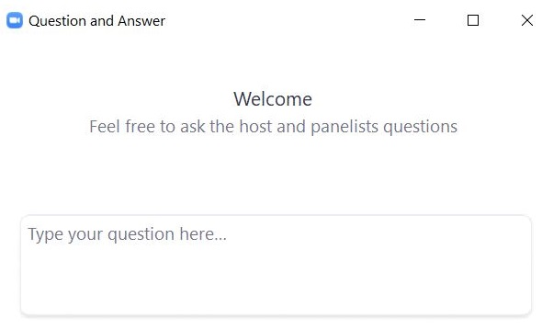
Questions and Answers
Use the Q&A feature to ask questions.

Slide 23
3. Early Release, Preliminary, & Discrepancy Reporting Schedules

Slide 24
Early Release Data Considerations
Results have not been filtered; all students who earned at least one point are included.
The following data are included in early release files, but results will not be aggregated with school/district for official reporting:
First-year ELs (validation file in DropBoxes in mid/late August)
Void/medical absence
Partially tested (didn’t attempt at least one item in each session)
Test status codes (absent, medical, security breach, transfer) and Typed Response Form items will appear in the preliminary file in August.

Slide 25
Preliminary Results and Discrepancy Reporting Periods
Preliminary Embargoed Results: Scaled Scores and Achievement Levels
June 25: Grade 10 ELA in DropBox Central*
Aug. 7: Grades 3–8, 10 ELA/Math; Grades 5 & 8 STE; high school science in DropBox Central
Aug. 14: Grades 3–8 10 ELA/Math; Grades 5 & 8 STE; high school science in Edwin Analytics
Mid-September: SGP available, with official embargoed results
Discrepancy Reporting Period
Aug. 7‒12: MCAS Service Center
Examine student rosters and data files for potential discrepancies (missing results; incorrect SASID; incorrect participation status). Details forthcoming in SAS Update (subscribe: eepurl.com/ghSOhH)
*A small number of students (~60 statewide) new to MA or tested with an incorrect SASID have blank CD status; check preliminary data in August for an update.

Slide 26
5. Resources, Support, & Next Steps

Slide 27
Additional Resources
Resource | Location
Edwin Analytics School and District Test Item Analysis Summary Report Video | www.doe.mass.edu/edwin/resources.html
MCAS Resource Center | mcas.pearsonsupport.com/
Modules and recordings of previous trainings | mcas.pearsonsupport.com/training/
PAN user information | mcas.pearsonsupport.com/pearsonaccessnext/
Student Assessment Updates (Biweekly email with important updates about the MCAS program) | www.doe.mass.edu/mcas/updates.html If you do not already receive this email, subscribe using this link: http://eepurl.com/ghSOhH

Slide 28
Email and Phone Support
MCAS Service Center
DESE Student Assessment Services
Questions on logistics
Web: mcas.pearsonsupport.com
Email: mcas@cognia.org
Phone: 800-737-5103
Policy and data questions
Web: www.doe.mass.edu/mcas
Email: mcas@mass.gov
Phone: 781-338-3625

Slide 29
Next Steps
Today: Complete the evaluation form.
Responses are associated with the name and email address used to log in.
Email your input to mcas@mass.gov if you have problems accessing or completing the form.
Within about a week:
Receive an email with the Q&A from this session
Recording will be available.

Slide 30
6. Graduation Requirements and the Updated CD Standard

Slide 31
Poll Question – Graduation Requirements
What determines a student’s MCAS graduation requirements?
their first year of high school
their year of graduation

Slide 32
Original Graduating Class
For purposes of 603 CMR 30.00, students are assigned to the graduating class of the cohort of students they join when they first enter grades 9–12 in a Massachusetts public school system. Once a student is assigned a particular cohort, the student’s graduating class never changes.
MCAS graduation requirements are available at https://www.doe.mass.edu/mcas/graduation.html

Slide 33
Competency Determination (CD) Requirements
Classes of 2024 and 2025
Subject | Option 1 | Option 2
ELA | Earn a score of 472 or higher | Earn a score of 455–471 and Fulfill the requirements of an Educational Proficiency Plan
Math | Earn a score of 486 or higher | Earn a score of 469–485 and Fulfill the requirements of an Educational Proficiency Plan
High School Science | Earn a score of 220 or higher on a legacy STE test or the interim passing standard for next-generation Biology (467) or Introductory Physics (470) | Not applicable (only one option for STE)

Slide 34
CD Requirements (cont’d)
Classes of 2026–2030
Subject | Option 1 | Option 2
ELA | Earn a score of 486* or higher | Earn a score of 470–485* and Fulfill the requirements of an Educational Proficiency Plan
Math | Earn a score of 486 or higher | Earn a score of 470–485* and Fulfill the requirements of an Educational Proficiency Plan
High School Science | Earn a score of 470 or higher on the Biology* or Introductory Physics test | Not applicable (only one option for STE)
* Updated requirements

Slide 35
Reporting Original Graduating Class
Students’ original graduating class can be found in the following reporting locations (grades 9–12 only):
.CSV files in DropBox Central
Student-level reports in Edwin Analytics, including (among others)
PE613 (Assessment History); PE617 (Student MCAS Roster); PE618 (CD Roster) PR600 (Student Profile)
Student Labels
Parent/Guardian Reports (example below)

Slide 36
THANK YOU
The Office of Student Assessment Services
781-338-3625
mcas@mass.gov
www.doe.mass.edu/mcas
135 Santilli Highway, Everett, MA 02149

